Slide 1
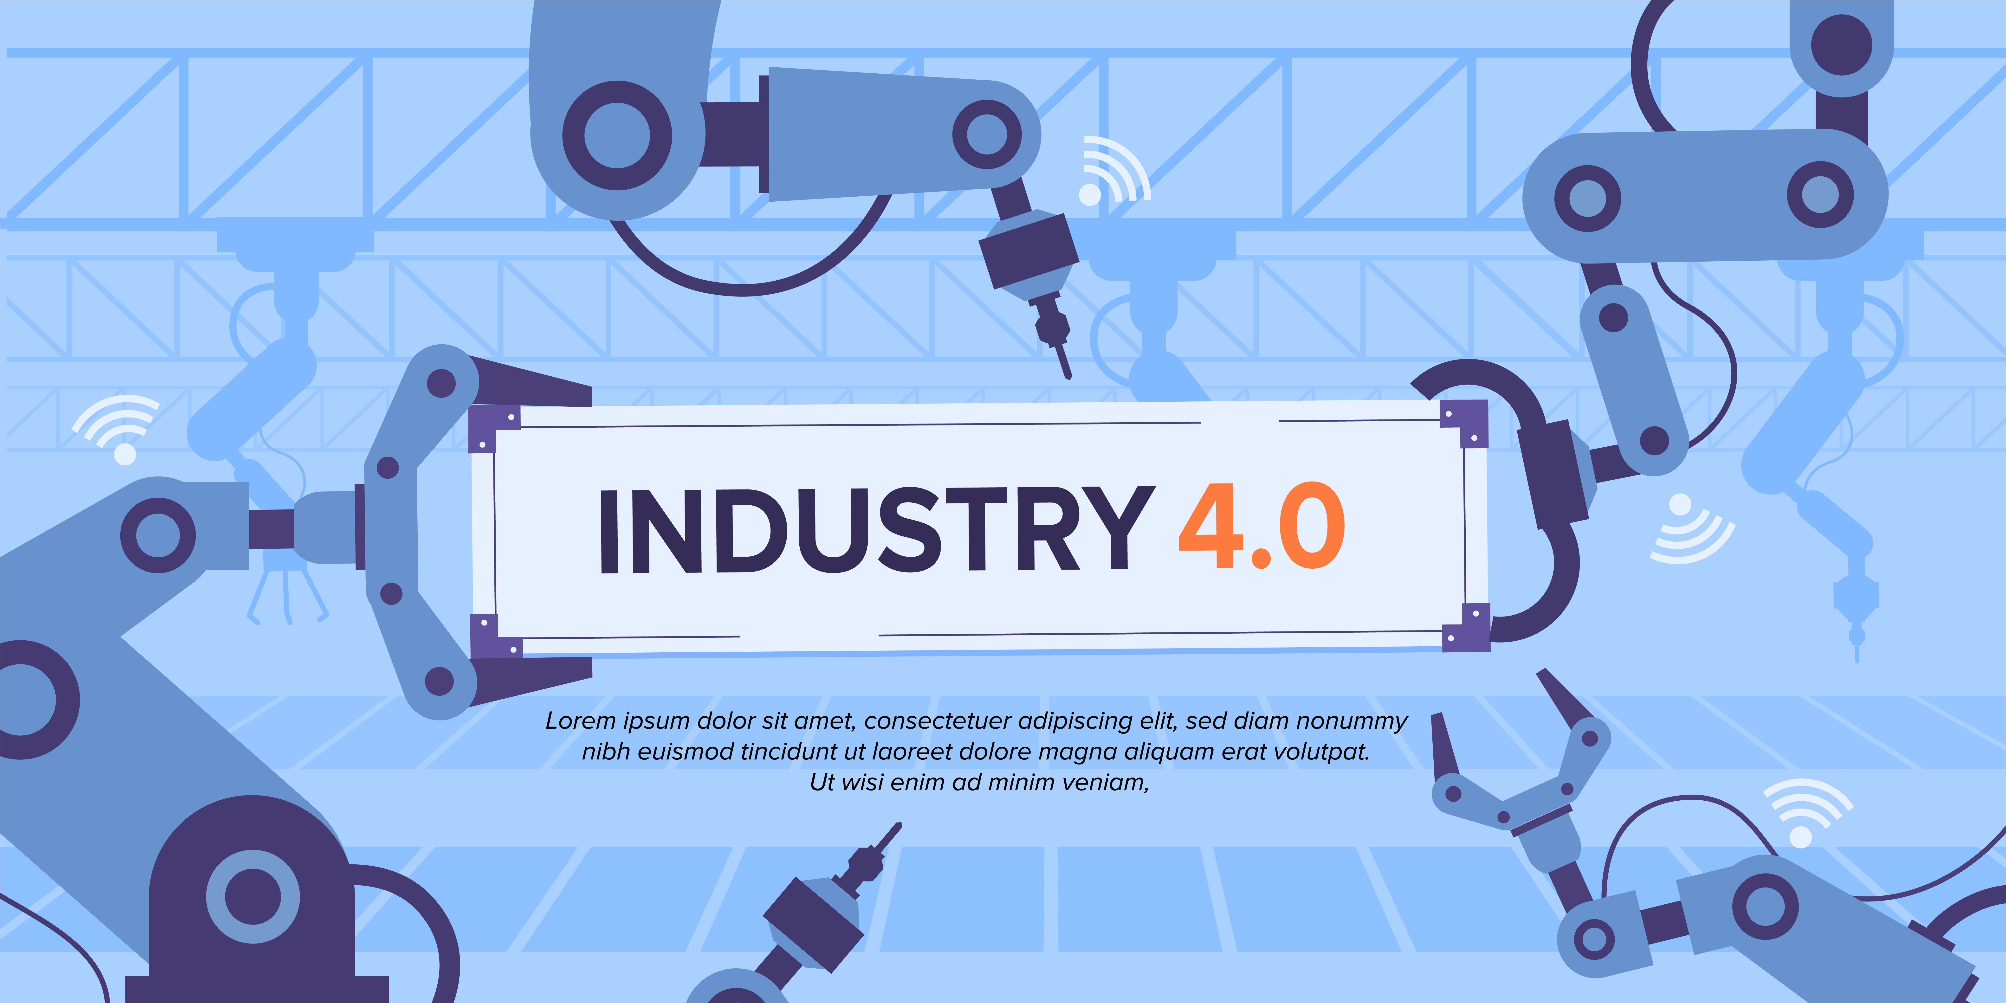
AI for the Industry 4.0
Images from https://www.freepik.com/

Slide 2
Challenge
Implementing the AI techniques to automate verification of produced fiber optic sensors.
Currently, after the production of the sensor,
its characteristics should be verified each time in three reference substances in order to configure:
Air
Water
Isopropanol

Slide 3
Goal
Time savings and cost reduction through AI algorithm implementation in order to predict characteristics of a working sensor in water and isopropanol based on measured characteristics in air.
This will shorten validation process only to measurements in air, but other characteristics will be collected based on the proposed model.

Slide 4
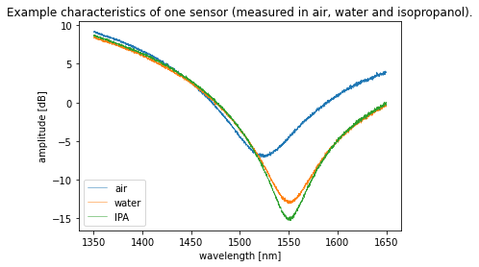
Currently, to configure the sensor,
3000 measurements need to be taken.
Using AI algorithms will reduce the number of measurements to 1000, which is 2/3 less.

Slide 5
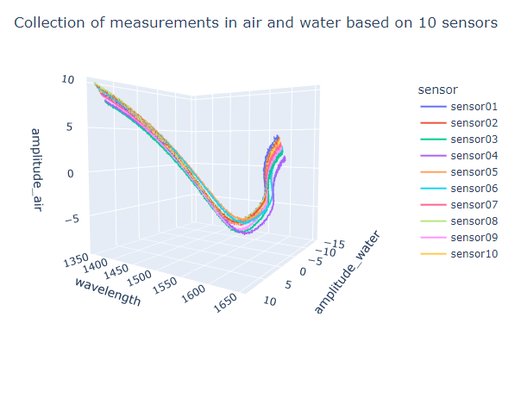
Verification of producted sensors
without AI algorithms requires
300%
more measurements for each sensor.

